Slide 1
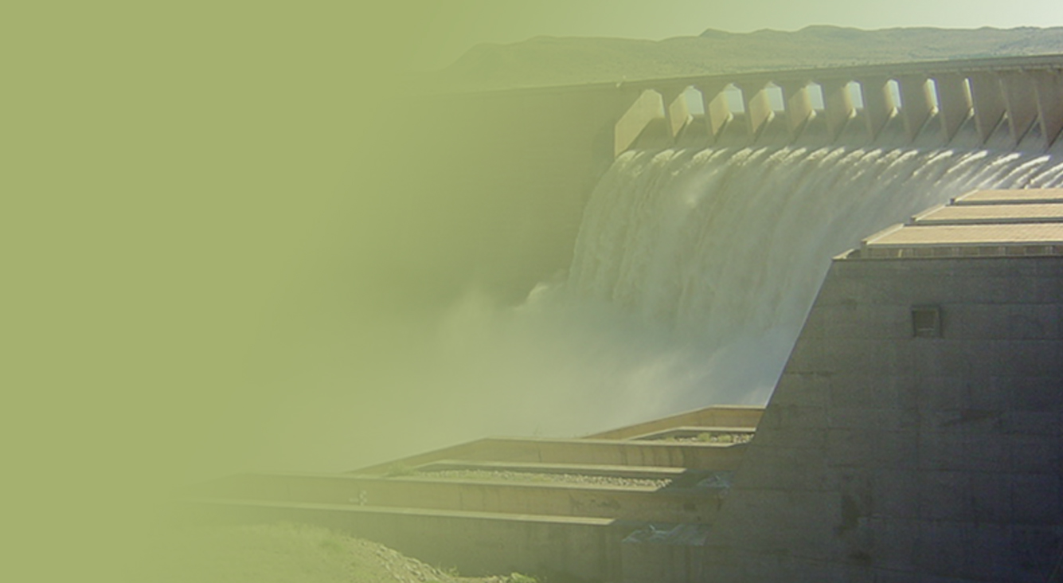
Support of the Water Reconciliation Strategy for the Algoa Water Supply System
Study Management Meeting – WUE
Real-Time Model
Aurecon
24 October 2017

Slide 2
Outline
Overview of the Operational Model
Improved Release Scheduling
More effective monitoring
Water Use Compliance type reports
Summary Water Balances
Conclusions
Notes:
It was originally planned to develop a further approximately 3 000 ha under irrigation in the Barkley Bridge area, for resource-poor farmers. Due to a lack of utilisation, the DWS in 2014 decided to made the 3 000 ha reserved below Barkley Bridge available to other HDI/emerging farmers in the Sundays River Valley. Of this, licences have to date been issued for 730ha, and applications for the use of such reserved water have been received for a further 2,038ha. It therefore seems very likely that the full 3000ha will be taken up in the foreseeable future.

Slide 3
Overview of the Operational Model
DSS to assist with operational planning and monitoring
Data
Models / Tools
Reports / Dissemination
DSS is integration of 3 major components
2 Versions of Real-time DSS model
2012 version running in Port Elizabeth (Pieter Retief)
Standalone PC with potential risks to sustainability and multiple user access
2017 version running of DWS Server in Pretoria (Systems Operation)
Client server technology with multi user access and sustainable backup processes
Notes:
It was originally planned to develop a further approximately 3 000 ha under irrigation in the Barkley Bridge area, for resource-poor farmers. Due to a lack of utilisation, the DWS in 2014 decided to made the 3 000 ha reserved below Barkley Bridge available to other HDI/emerging farmers in the Sundays River Valley. Of this, licences have to date been issued for 730ha, and applications for the use of such reserved water have been received for a further 2,038ha. It therefore seems very likely that the full 3000ha will be taken up in the foreseeable future.

Slide 4
Overview of the Operational Model
External Data
OFS Operational Model
Real-Time Data
Flow, Level, Rainfall, Storage,
Elec. Conductivity
TS management
Import Data
GIS Management
E-mail/spreadsheets
Script /Code Management
Water Requests
GFRWUA
LSRWUA
Automated Data import and processing Jobs
Process data
Flood Management
DB
MIKE11 Flow Model
Verified Data
Flow
Level
Storage
Run scenarios
Model Scenario Management
Hydstra DB
Reporting Tools
Produce data / model reports
Notes:
It was originally planned to develop a further approximately 3 000 ha under irrigation in the Barkley Bridge area, for resource-poor farmers. Due to a lack of utilisation, the DWS in 2014 decided to made the 3 000 ha reserved below Barkley Bridge available to other HDI/emerging farmers in the Sundays River Valley. Of this, licences have to date been issued for 730ha, and applications for the use of such reserved water have been received for a further 2,038ha. It therefore seems very likely that the full 3000ha will be taken up in the foreseeable future.

Slide 5
Use of Operational Model for Algoa Reconciliation Project
Analysis of 2014 / 2015 and 2015 / 2016 water years to assess potential for improved releases and subsequent water savings
On-going PSP support to DWS Operational Team to manage and plan release scheduling and data reports

Slide 6
Improved Release Scheduling
Improved Release Scheduling
Reduce operational allowance river release at Elandsdrift to 1.5 m³/sec
Accurately maintain DeMistkraal river release to 1 m³/sec operational allowance
Utilise lagged releases from base of network to solve water balance every week
Fewer changes at Elandsdrift and DeMistkraal Canal Releases; more frequent changes at Grassridge
Proactive management of volumes at Elandsdrift
Try not to treat Darlington as a ‘backstop’
Potential to save 31 MCM per year in reduced spills at Piggott's Bridge
Notes:
It was originally planned to develop a further approximately 3 000 ha under irrigation in the Barkley Bridge area, for resource-poor farmers. Due to a lack of utilisation, the DWS in 2014 decided to made the 3 000 ha reserved below Barkley Bridge available to other HDI/emerging farmers in the Sundays River Valley. Of this, licences have to date been issued for 730ha, and applications for the use of such reserved water have been received for a further 2,038ha. It therefore seems very likely that the full 3000ha will be taken up in the foreseeable future.

Slide 7
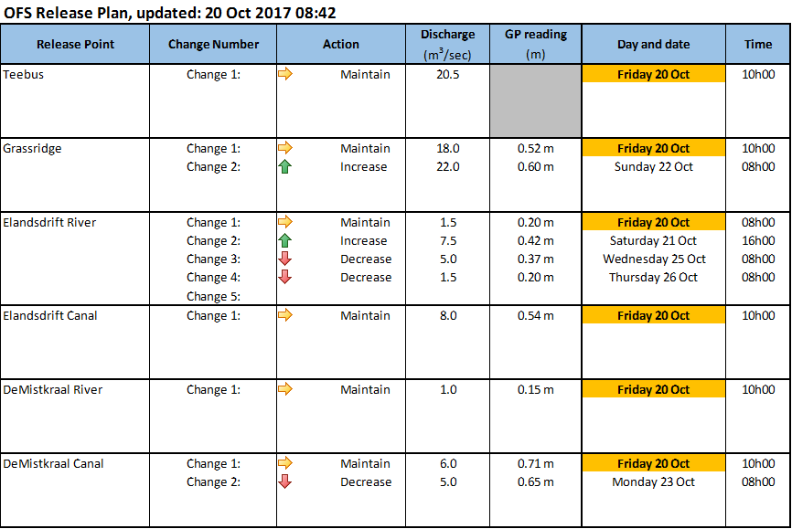
Improved Release Scheduling
Notes:
It was originally planned to develop a further approximately 3 000 ha under irrigation in the Barkley Bridge area, for resource-poor farmers. Due to a lack of utilisation, the DWS in 2014 decided to made the 3 000 ha reserved below Barkley Bridge available to other HDI/emerging farmers in the Sundays River Valley. Of this, licences have to date been issued for 730ha, and applications for the use of such reserved water have been received for a further 2,038ha. It therefore seems very likely that the full 3000ha will be taken up in the foreseeable future.

Slide 8
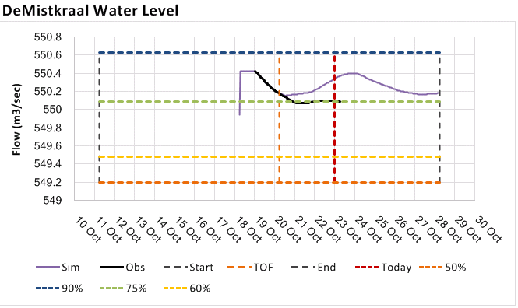
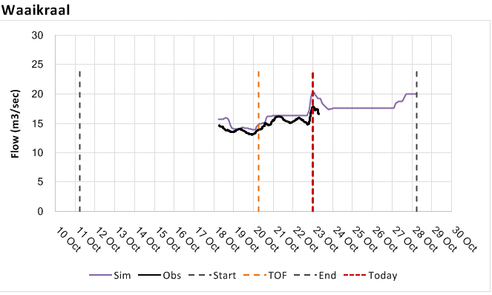
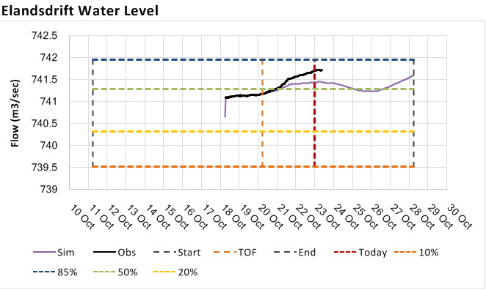
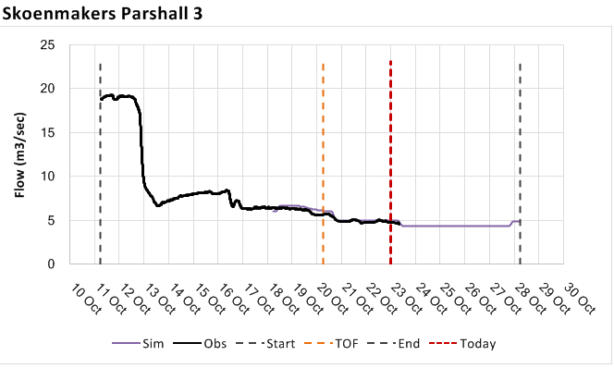
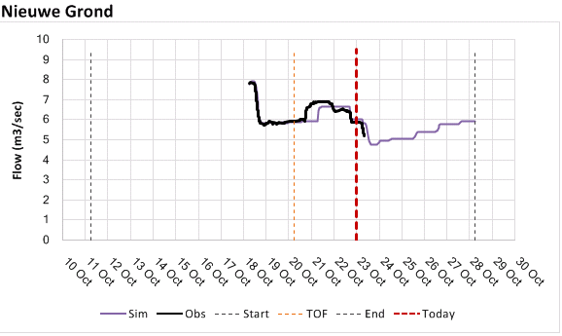
Forecast Levels and Flows
Notes:
It was originally planned to develop a further approximately 3 000 ha under irrigation in the Barkley Bridge area, for resource-poor farmers. Due to a lack of utilisation, the DWS in 2014 decided to made the 3 000 ha reserved below Barkley Bridge available to other HDI/emerging farmers in the Sundays River Valley. Of this, licences have to date been issued for 730ha, and applications for the use of such reserved water have been received for a further 2,038ha. It therefore seems very likely that the full 3000ha will be taken up in the foreseeable future.

Slide 9
2017 / 2018 Water Year

Slide 10
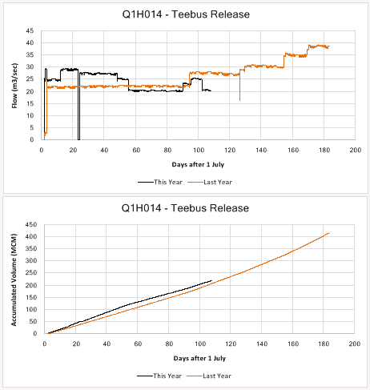
Teebus
+11 MCM relative to 2016

Slide 11
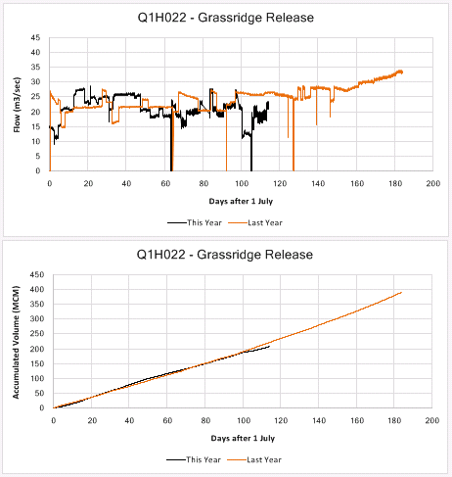
Grassridge
-14 MCM relative to 2016

Slide 12
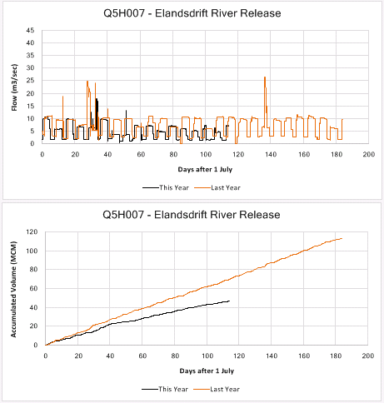
Elandsdrift River Release
-22 MCM relative to 2016

Slide 13
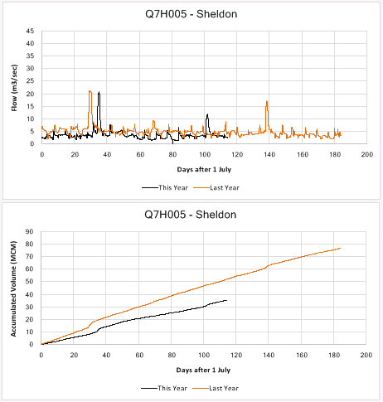
Sheldon Comparison
-17 MCM relative to 2016

Slide 14
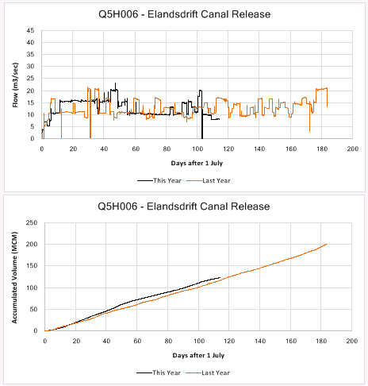
Little Fish Canal
+6 MCM relative to 2016

Slide 15
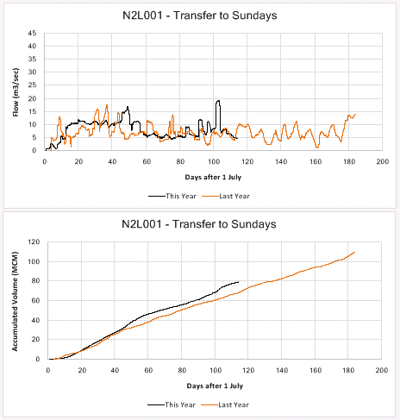
Transfer to Sundays
+11 MCM relative to 2016

Slide 16
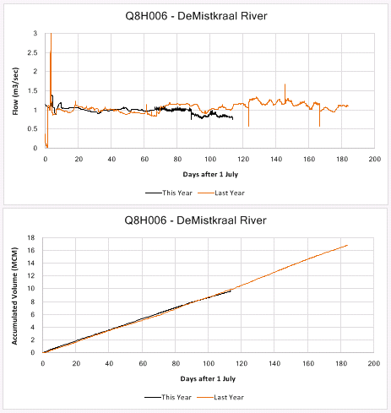
DeMistkraal River Release
-0.3 MCM relative to 2016

Slide 17
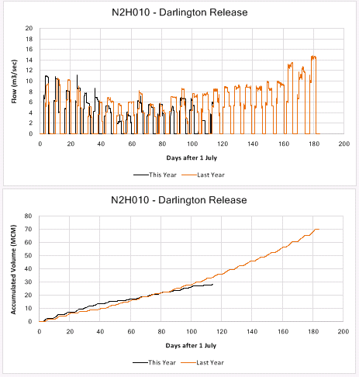
Darlington Release
-5 MCM relative to 2016

Slide 18
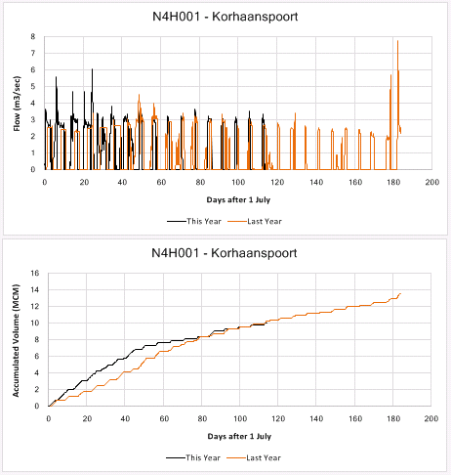
Kohaansdrift Spill
-0.3 MCM relative to 2016

Slide 19
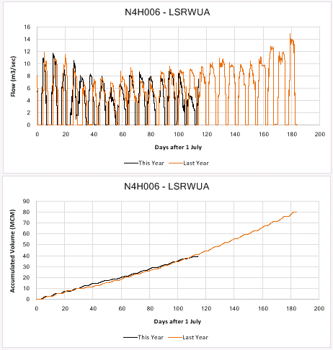
LSRWUA
-1.5 MCM relative to 2016

Slide 20
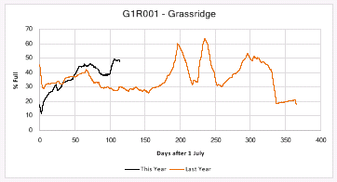
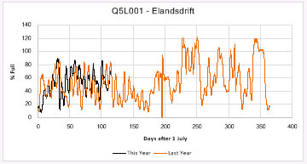
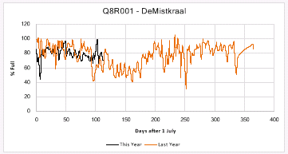
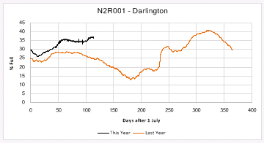
Storage
+27 MCM since start of water year

Slide 21
Summary YTD 2016
More water transferred from Teebus, but…
Reduced releases from Grassridge, Elandsdrift River, Darlington
Increase in Stored Water
Trend will be less water transferred from Teebus in first half 2017 / 2018 water year

Slide 22
Available Data Reports
Abstraction compliance with request and allocation
Volume based: monthly and annual
Fine timescale: primary data
Approximate section water balances
Notes:
It was originally planned to develop a further approximately 3 000 ha under irrigation in the Barkley Bridge area, for resource-poor farmers. Due to a lack of utilisation, the DWS in 2014 decided to made the 3 000 ha reserved below Barkley Bridge available to other HDI/emerging farmers in the Sundays River Valley. Of this, licences have to date been issued for 730ha, and applications for the use of such reserved water have been received for a further 2,038ha. It therefore seems very likely that the full 3000ha will be taken up in the foreseeable future.

Slide 23
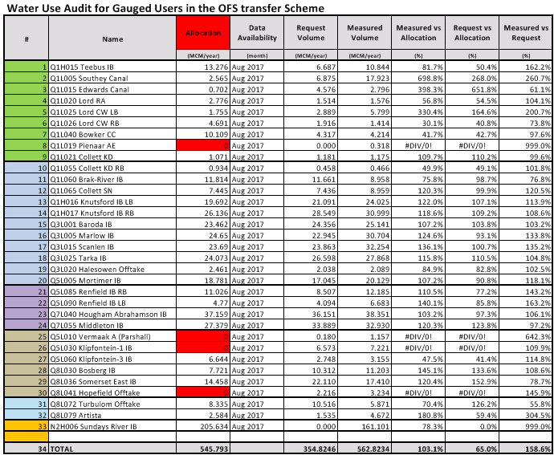
Abstraction Compliance (volume based 2016)

Slide 24
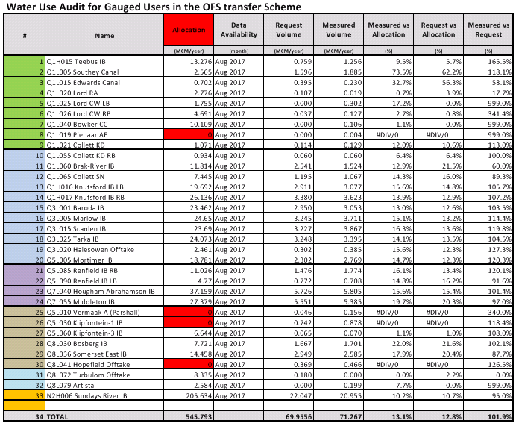
Abstraction Compliance (volume based 2017)

Slide 25
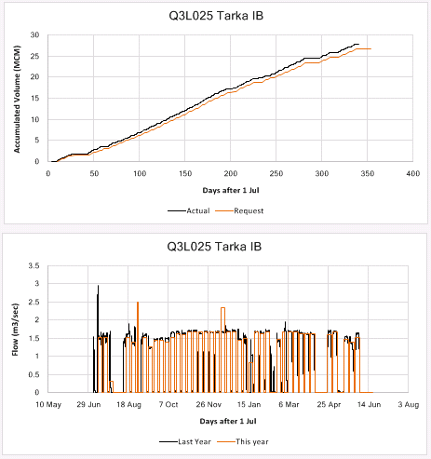
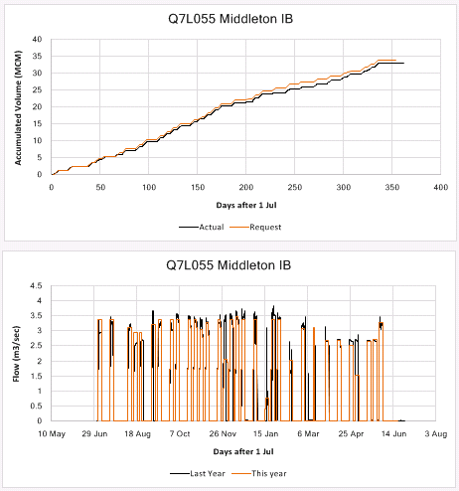
Abstraction Compliance (Examples)

Slide 26
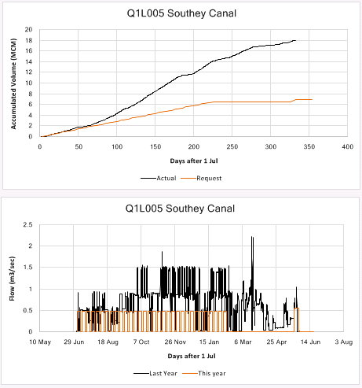
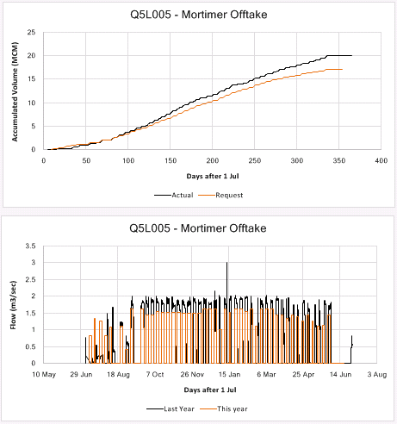
Abstraction Compliance (Examples)

Slide 27
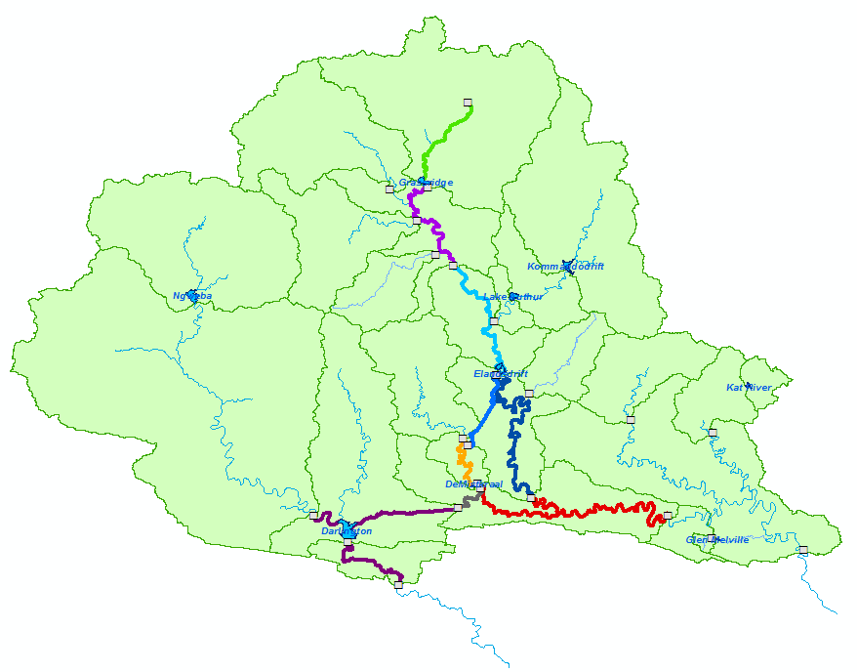
Available Data Reports
Summary water balances for 9 different sections
Teebus to Grassridge
Grassridge to Waaikraal
Waaikraal to Elandsdrift
Elandsdrift to Sheldon
Little Fish Canal
Upper Little Fish River
Lower Great Fish River
Skoenmakers Canal
Sundays (Parshall 3 to Korhaansdrift)
Notes:
It was originally planned to develop a further approximately 3 000 ha under irrigation in the Barkley Bridge area, for resource-poor farmers. Due to a lack of utilisation, the DWS in 2014 decided to made the 3 000 ha reserved below Barkley Bridge available to other HDI/emerging farmers in the Sundays River Valley. Of this, licences have to date been issued for 730ha, and applications for the use of such reserved water have been received for a further 2,038ha. It therefore seems very likely that the full 3000ha will be taken up in the foreseeable future.

Slide 28
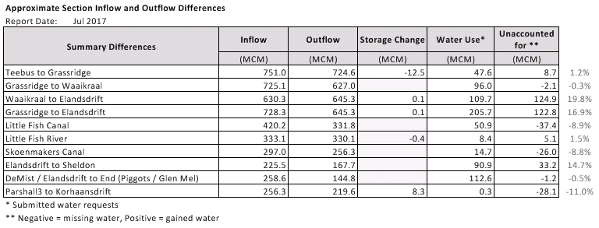
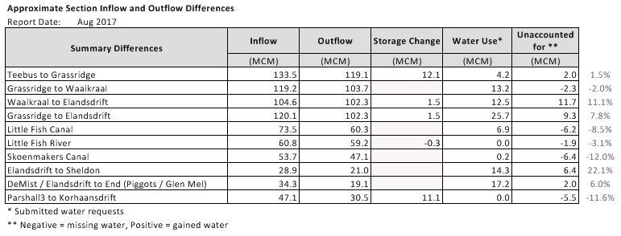
Available Data Reports
Notes:
It was originally planned to develop a further approximately 3 000 ha under irrigation in the Barkley Bridge area, for resource-poor farmers. Due to a lack of utilisation, the DWS in 2014 decided to made the 3 000 ha reserved below Barkley Bridge available to other HDI/emerging farmers in the Sundays River Valley. Of this, licences have to date been issued for 730ha, and applications for the use of such reserved water have been received for a further 2,038ha. It therefore seems very likely that the full 3000ha will be taken up in the foreseeable future.

Slide 29
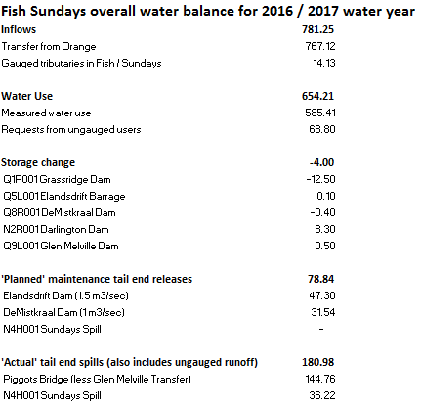
Scheme Water Balance

Slide 30
Conclusions
Current Year Water savings are being realised!
More accurate scheduling of releases to Lower Great Fish River at Elandsdrift
Operational changes at LSRWUA Korhaansdrift Weir
Compliance with water requests critical to effective operations to make maximum use of local runoff:
Operating DeMistkraal and Elandsdrift at Lower Level to limit canal capacity constraints
Less variation in Elandsdrift and DeMistkraal Canal releases
More effective management of Grassridge release, lower volume of water released
Maintain constant water levels in Little Fish and Skoenmakers Canal
Better compliance of water users in GFRWUA
Notes:
It was originally planned to develop a further approximately 3 000 ha under irrigation in the Barkley Bridge area, for resource-poor farmers. Due to a lack of utilisation, the DWS in 2014 decided to made the 3 000 ha reserved below Barkley Bridge available to other HDI/emerging farmers in the Sundays River Valley. Of this, licences have to date been issued for 730ha, and applications for the use of such reserved water have been received for a further 2,038ha. It therefore seems very likely that the full 3000ha will be taken up in the foreseeable future.

